Slide 1
Producing Scale Drawings
Miss L
Year 12 Essentials

Slide 2

From Last Lesson

Slide 3

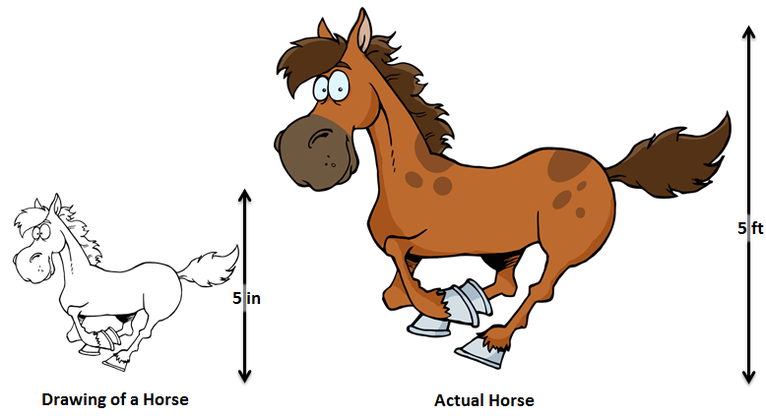
24
7
30
Producing Scale Drawings
Date
EQ – How do we produce scale drawings?

Slide 4


Slide 5
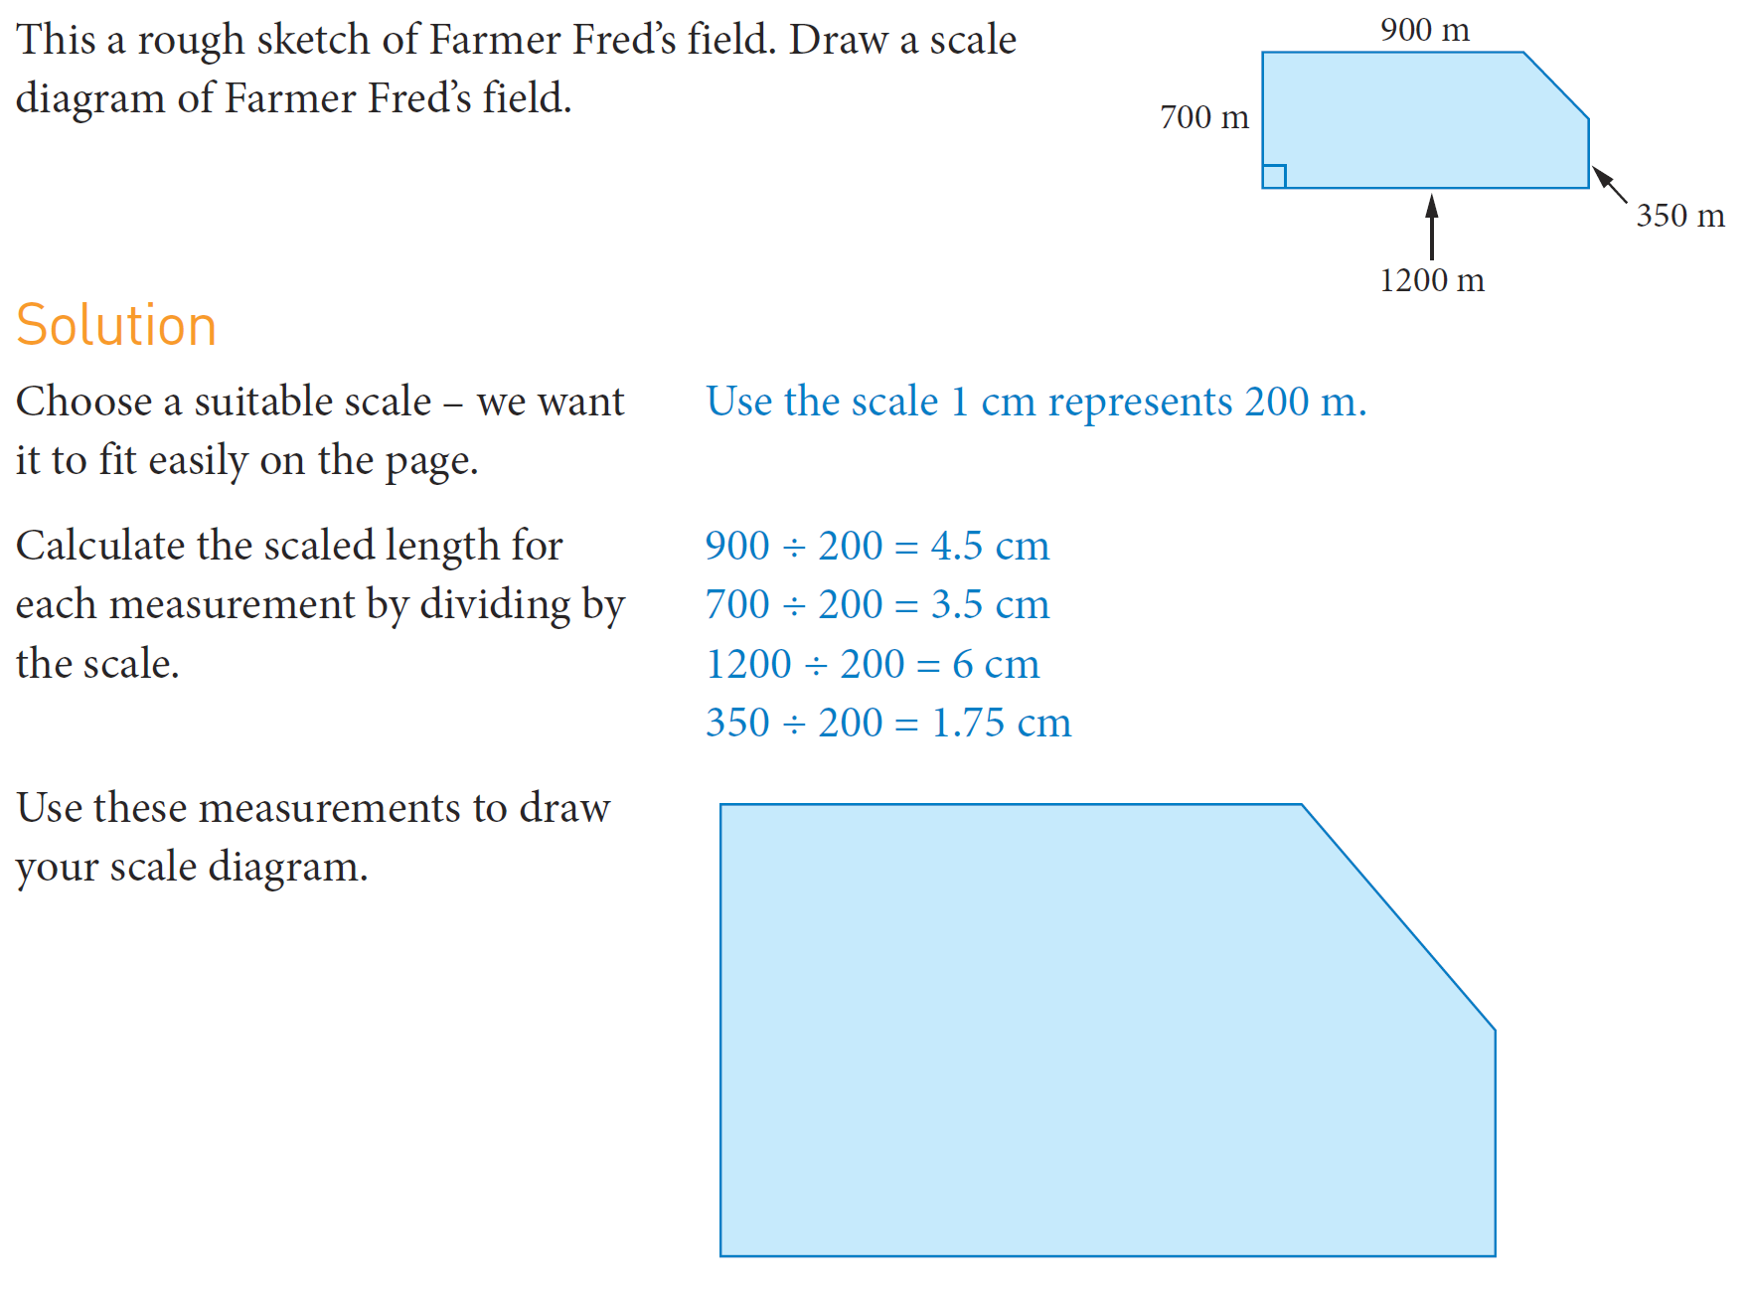
Practice

Slide 6
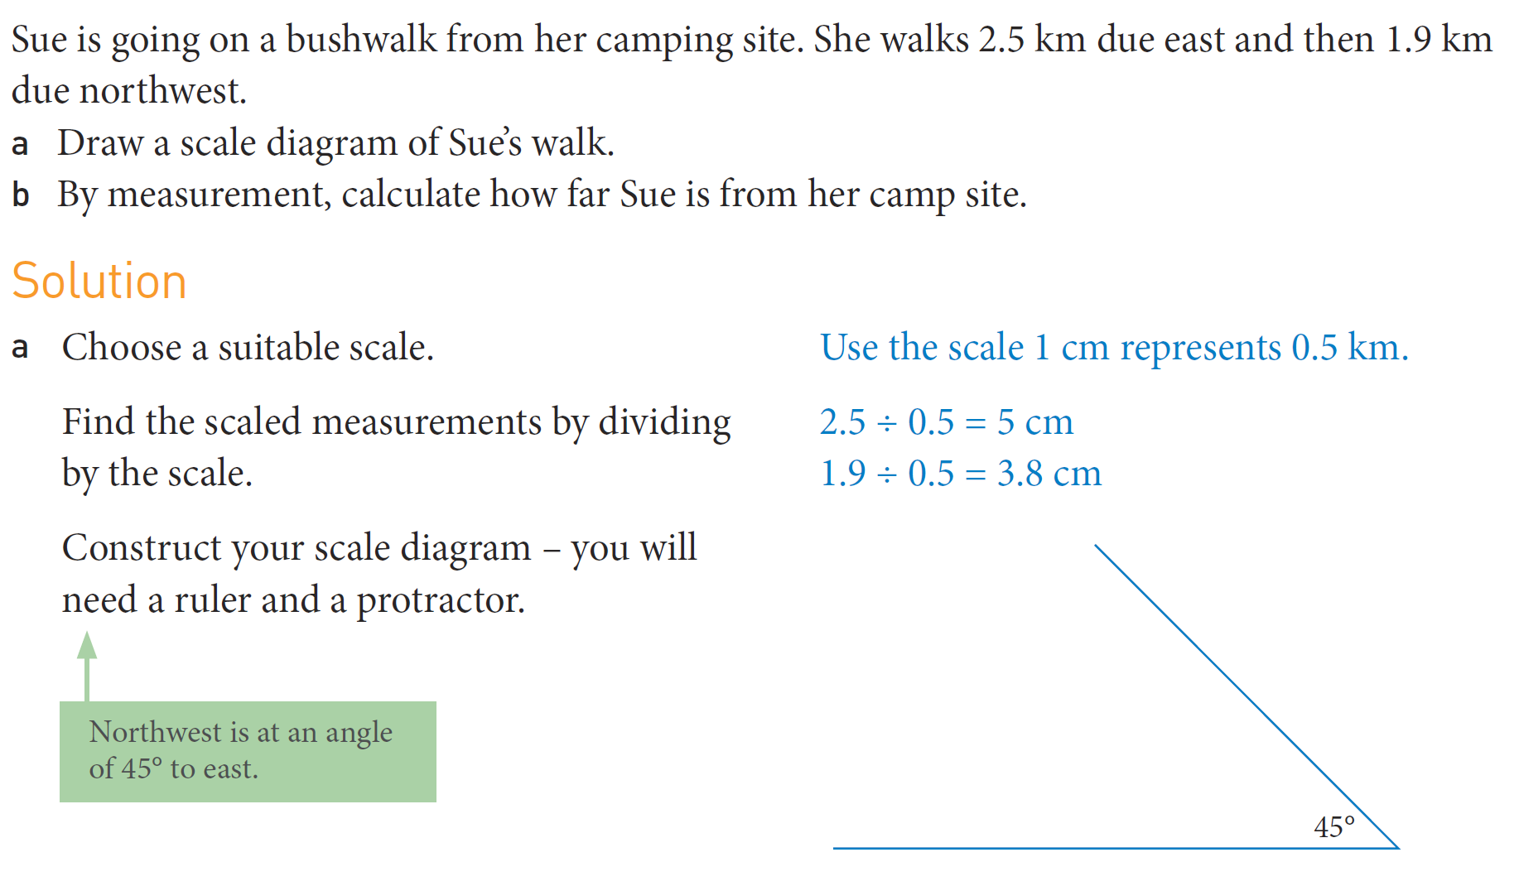
Practice

Slide 7

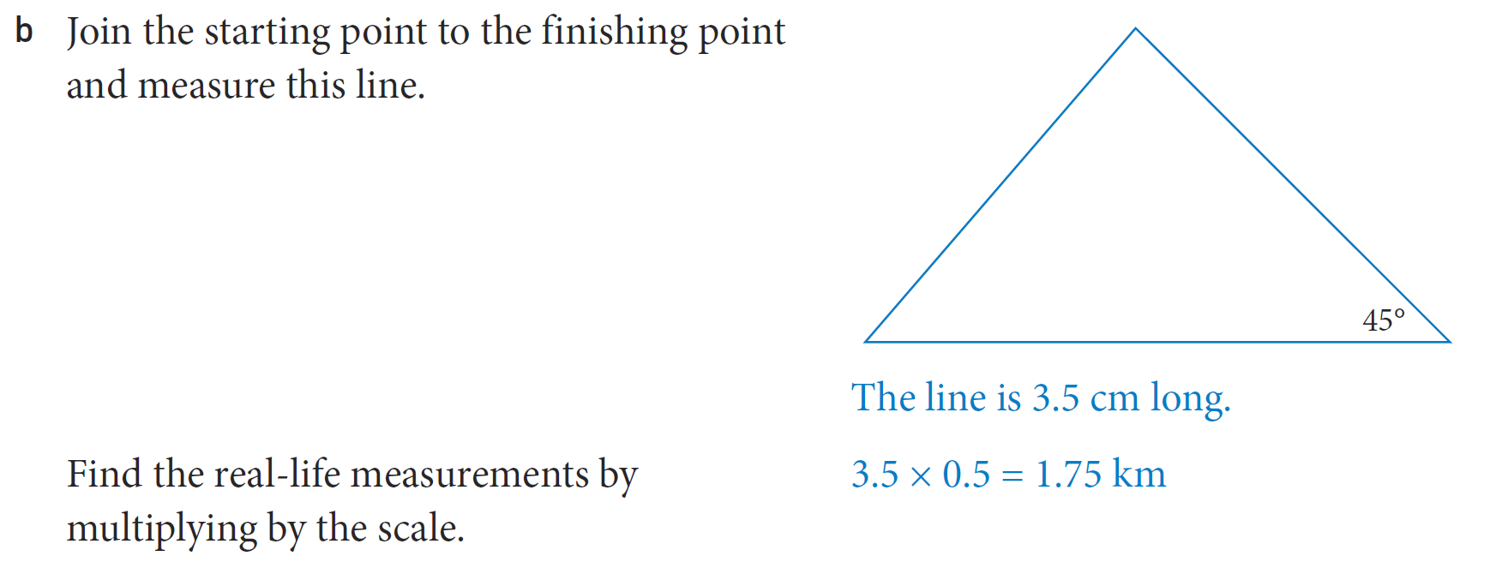

Slide 8

Practice

